Slide 1

Video compression--MPEG
MPEG method
  Spatial compression
    The spatial compression of each frame is done with JPEG.
  Temporal compression
    The temporal compression removes the redundant frames.
    MPEG method first divides frames into three categories: I-frames, P-frames, B-frames.

Slide 2
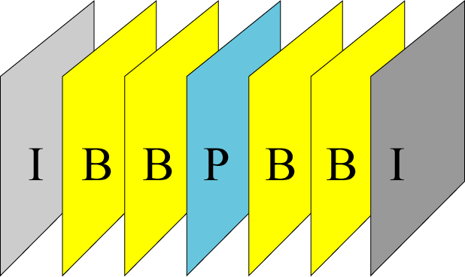
Figure 15-16
MPEG frames
I-frames: (intra-coded frame)
  It is an independent frame that is not related to any other frame.
  They are present at regular intervals.
  I-frames are independent of other frames and cannot be constructed from other frames.

Slide 3
Figure 15-16
MPEG frames
P-frames: (predicted frame)
  It is related to the preceding I-frame or P-frame.
  Each P-frame contains only the changes from the preceding frame.
  P-frames can be constructed only from previous I- or P-frames.
B-frames: (bidirectional frame)
  It is relative to the preceding and following I-frame or P-frame.
  Each B-frame is relative to the past and the future.
  A B-frame is never related to another B-frame.

Slide 4
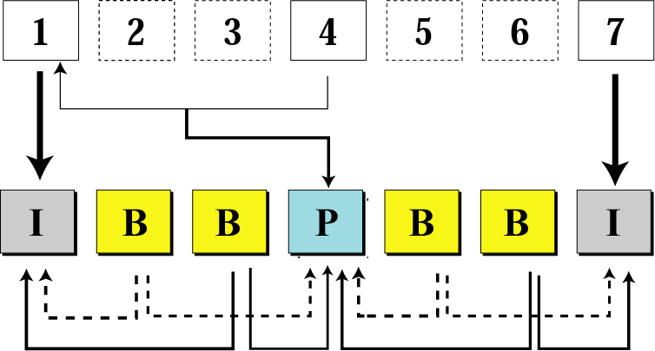
Figure 15-17
Input sequence
MPEG frame construction
MPEG sequence

